Slide 1
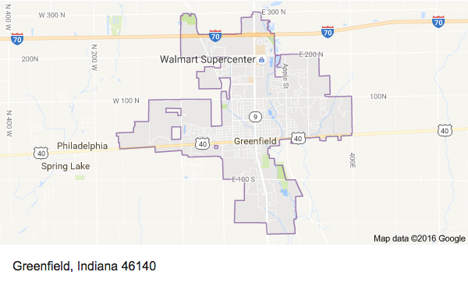
Making Your next Move
The choice is yours!
What you need to know about taking your next steps

Slide 2
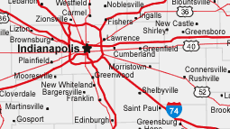
Step 1: Find the perfect fit
College Campus Visits
College Visits to G-CHS
College Fairs
Application Process
Standardized Testing

Slide 3
College campus visits
College visits To G-CHS
Juniors & Seniors are allowed 2 per semester
Family makes the appointment and informs the counselor of the date
Counselor shares with attendance office
Parent calls in the visit to the attendance office the day of the visit
Student brings back a confirmation to attendance the next day
Seniors: schedule a visit for October 25 NOW!
Juniors and Seniors are allowed to attend 3 visits each year
Students sign-up online and are sent a pass the day of the visit
College Fairs – Please Attend One!
Education Expo – Hancock County Fairgrounds
Wednesday, September 27 from 6:00 – 7:30 PM
National College Fair
Friday, October 20 9:00 AM – 1:00 PM (register ahead of time)

Slide 4
The College Application Process
Most admission applications are done online
Students can use an individual college or university application or the Common Application (required by Purdue/IU Bloomington is using it this year, too)
Students will submit counselor information so we can complete counselor recommendations electronically (eSSR)
ALL transcripts are submitted electronically through Family Connection. Students must submit the application and request a transcript.
Students must create an account through Family Connection to request transcripts
Students need to give the counseling staff at least a week to process secondary school reports and transcripts. Please do not expect these to be uploaded the same day you request it so pay attention to application deadlines.

Slide 5
Standardized Testing – SAT & ACT
Seniors should be registered for the October 7 SAT if they have not already taken a test or want to improve their current scores.
All test registration is done online so students must create accounts with The College Board (SAT) and ACT.
The registration deadline for the October SAT is Friday, September 8! G-CHS is hosting this test.
Juniors should take an ACT and SAT no later than the spring of their junior year (April-June) – earlier is OK.
Most colleges “super score” the tests so taking it multiple times is fine.
Students who plan to participate in NCAA collegiate athletics must submit their test scores directly from The College Board (SAT) and/or ACT. The NCAA will not accept test scores from our transcript.

Slide 6
Need Help improving your test scores?
G-CHS is hosting a test prep workshop (ZAPS) next Friday, September 8 during the school day for juniors and seniors who would like to raise their test scores.
Registration is still open and there are plenty of seats still available. Register by visiting www.doorwaytocollege.com or calling (877)-927-8378.

Slide 7
Step 2: Finance the way
Financial Aid
Scholarships

Slide 8
Financial Aid
The first day to file the FAFSA form is October 1, 2017.
Families will use “prior prior” tax information meaning you will use your 2016 tax return - no need to wait to use your 2017 information!
G-CHS will be hosting a FAFSA completion day on November 6 from 2:00 – 7:30 PM. Parents and students who have questions about filing the FAFSA or need help getting started or completing it should plan to attend.
Both students and parents will need to create FSA IDs before filing outthe FAFSA. Seniors can do that now, but don’t forget them!

Slide 9
Scholarship Information
The counseling office posts all received scholarship opportunities in Family Connection
We also have a Remind account for reminding students to check Family Connection for scholarships. To join, text @eh334 to 81010.
To get e-mail messages, send an e-mail to eh334@mail.remind.com.
Seniors and their parents should check Family Connection and join the Remind group for the most up-to-date scholarship information.
Students need to give the counseling office time to process and send transcripts for scholarships. Applications that need “official” transcripts must be processed by us.

Slide 10
Step 3: Stay on the Right Path
Important Dates
Important Links

Slide 11
Important Dates
Sept. 8: Registration deadline for Oct. 7 SAT
Sept 9: ACT @ G-C (registration deadlines have passed)
Sept. 27 6:00 – 7:30 PM Hancock Co. Education Expo College Fair
Oct 7: SAT @ G-C
Oct 25: “Don’t Fear the Future”
Seniors: College Visit, Job Shadow, Mentor/Protégé, or ASVAB
Juniors: PSAT or ACCUPLACER*
Dec. 2: SAT @ G-C
April 14: ACT @ G-C
May 5: SAT @ G-C
May 7 - May 18 - AP exams
May 29 - 31: 2nd Semester Finals
June 8: Senior Awards Night
June 9: Commencement
*Students required to take the ACCUPLACER may take the PSAT.

Slide 12
Important Links
Education Expo – College Fair
http://educatehancockcounty.com/
National College Fair (pre-registration)
http://www.nacacnet.org/college-fairs/FallNCF/Pages/Indianapolis.aspx
Family Connection
http://connection.naviance.com/greenfieldchs
The College Board (SAT test registration)
https://collegereadiness.collegeboard.org/sat?navId=gh-sat
ACT (ACT test registration)
http://www.act.org/content/act/en/register.html

Slide 13
Step 4: Know the Experts
College Admission
Chris Potts, Associate Director of Admission at Butler University (Cougar Meeting Room)
Financial Aid
Robert Sommers, INvestED (Auditorium)
Scholarships
Marie Felver, Vice President of Finance and Operations at the Hancock County Community Foundation (Library)

